Slide 1
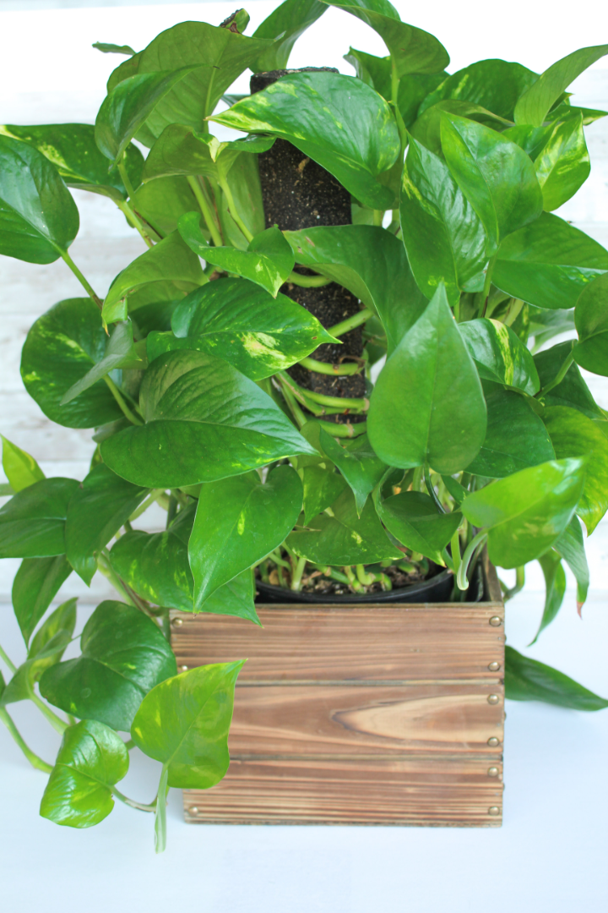
The Money Minting Indoor Plant: Cultivate Wealth at Home
Money Minting Indoor Plant, a remarkable addition to your home and your financial journey!
BY
Sharafunneesa
Sajin
Shahana

Slide 2

The Power of Indoor Gardening
Indoor gardening has always brought a touch of nature into our homes. But now, it brings wealth right to your living room.

Slide 3
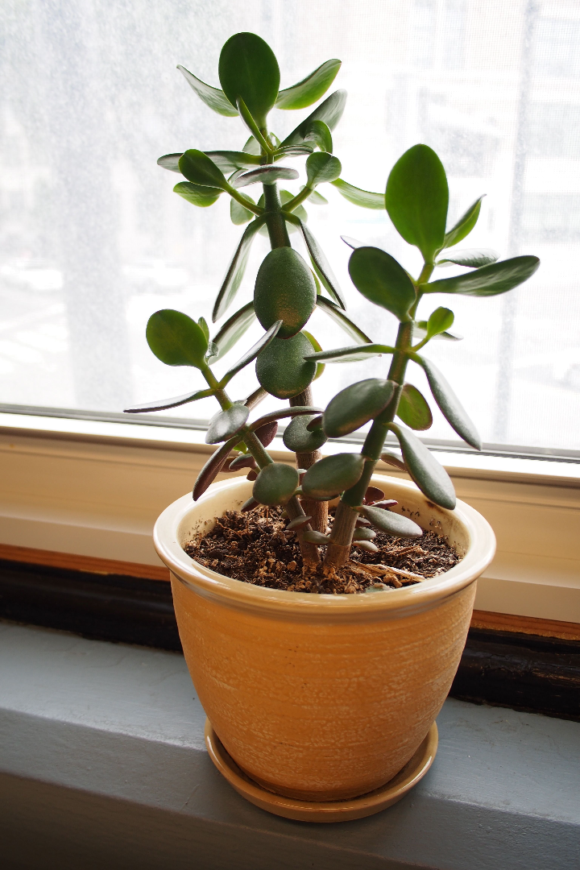
Meet the Money Minting Indoor Plant
This is not your typical houseplant. Our Money Minting Indoor Plant is a unique blend of nature and wealth.

Slide 4
Growing Your Money Minting Plant
Planting the Money Minting Seed
Indoor conditions and lighting requirements
Watering and care instructions
Monitoring growth stages

Slide 5
Planting the Money Minting Seed
Financial Gain
Creating the right environment.
Select a healthy Money Minting Seed.
Plant the seed in a well-draining pot with nutrient-rich soil.
Water the soil to provide moisture for germination.
Place the pot in an area with indirect sunlight..
Ideal Temperature Range: 65-75°F (18-24°C).
Indirect Light: Place the plant near a window with indirect sunlight.
Humidity: Maintain moderate indoor humidity levels.
Avoid Drafts: Protect the plant from cold draft
Proper care
Monitoring Growth Stages
Keep the soil consistently moist but not waterlogged.
Pruning: Trim any dead or yellowing leaves to encourage new growth.
Fertilizing: Use a balanced, all-purpose indoor plant fertilizer every 4-6 weeks.
Repotting: As the plant grows, transfer it to a larger pot to accommodate its increasing size.
Germination: The first currency leaves emerge within a few weeks.
Currency Growth: Over time, physical money in the form of coins and bills appears on the plant's branches.
Pruning and Maintenance: Regular care helps to shap.
Harvesting: When you notice a bountiful display of currency, it's time to harvest your money. Use scissors to carefully cut the 'currency' from the branches.

Slide 6
Financial Gain
Natural Air Purification
The Money Minting Indoor Plant not only grows money but also cleans the air, improving your home's atmosphere.
Aesthetic Appeal
A Relaxing and Rewarding Hobby
Add a touch of elegance to your home with the lush green leaves and the unique currency-laden branches of the Money Minting Plant.
Nurture your Money Minting Plant as a hobby and enjoy the therapeutic benefits of indoor gardening while growing your wealth.

Slide 7

Disadvantages
1
Patience Required
2
Space and Light Constraints
Growing your money takes time. Be patient and follow the growth stages to harvest your wealth.
Ensure you have adequate space and lighting in your home to accommodate the Money Minting Indoor Plant's growth.
3
Currency Management
Handling and managing currency on the plant's branches requires a careful and organized approach.

Slide 8

Pricing and Justification
What's the investment needed to start your own Money Minting Indoor Plant?
1
2
High-quality plant seeds and care instructions
Support and guidance for indoor gardeners
Our Money Minting Plant package includes premium seeds and detailed care instructions to ensure the success of your wealth cultivation.
As part of your purchase, you'll have access to our expert support team who can provide guidance and answer any questions you may have.
3
Opportunity for ongoing wealth cultivation
The investment in the Money Minting Indoor Plant provides not only an initial return but also ongoing opportunities for wealth cultivation.

Slide 9

Testimonials from Thrilled Indoor Gardeners
But don't just take my word for it. Hear from our satisfied indoor gardeners who've reaped the benefits of our Money Minting Indoor Plant.

Slide 10
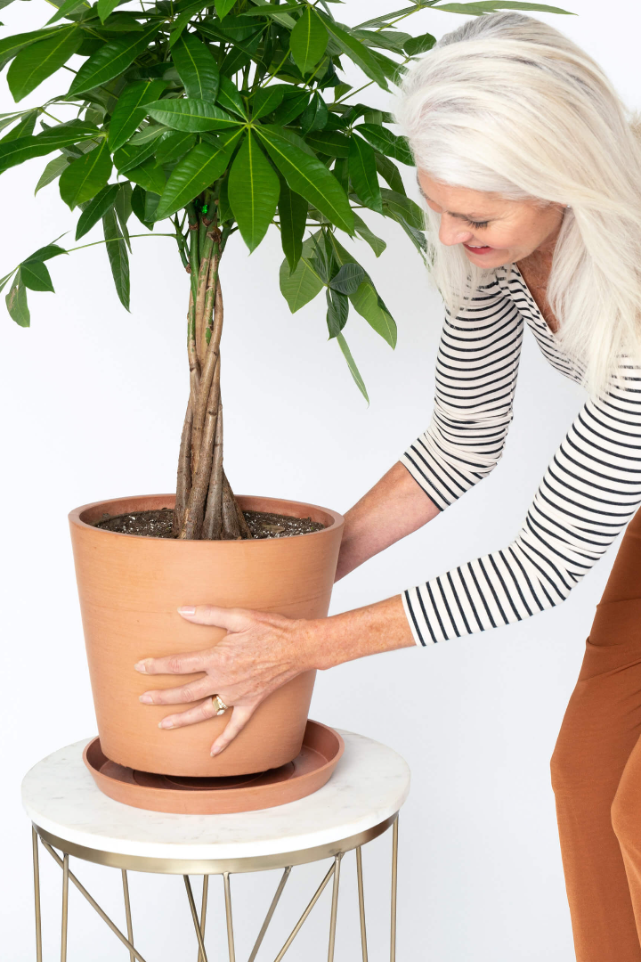
Get Your Money Minting Indoor Plant
Ready to start your own indoor garden of wealth? Here's how you can get your very own Money Minting Indoor Plant.

Slide 11

Conclusion
The Money Minting Indoor Plant offers a unique blend of nature and wealth, bringing the beauty of gardening into your home while cultivating your financial success.

